Slide 1
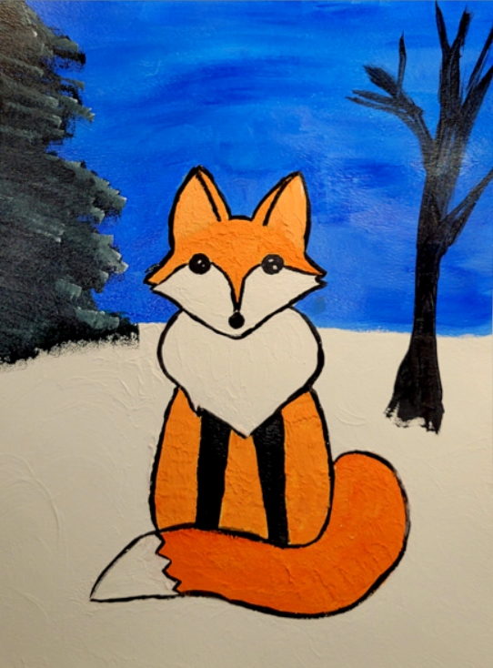
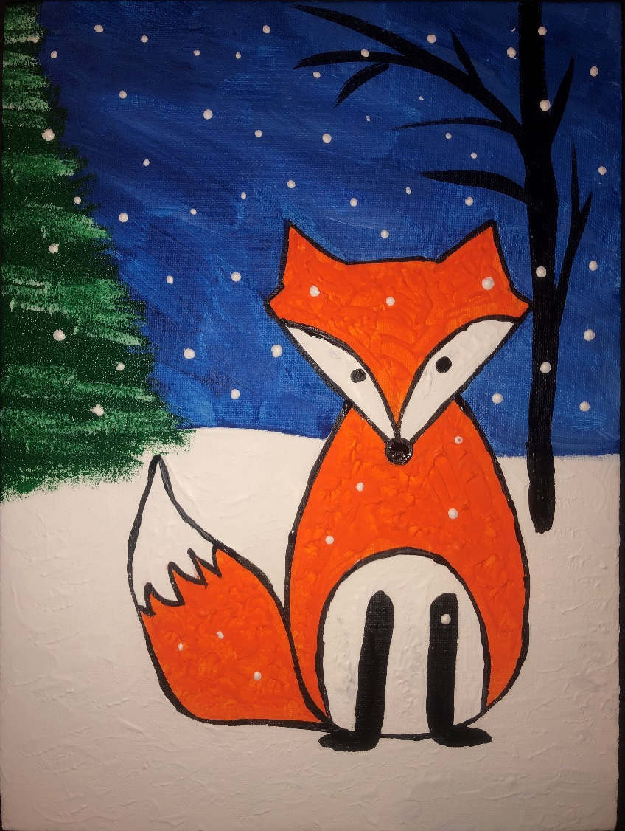
Winter Fox Acrylic using texture
Updated 2023

Slide 2
What is Joint compound? It is a white powder of primarily gypsum dust mixed with water to form a mud the consistency of cake frosting, which is used with paper or fiber joint tape to seal joints between sheets of drywall to create a seamless base for paint on interior walls. So why are we talking about walls?! We can use everyday materials in ART!
Mixing joint compound with acrylic paint gives us…
TEXTURE

Slide 3
VS.
Joint Compound
12 lbs (192 oz) = $12.99
$0.07/oz
Liquitex stucco
8 oz = $11.70
$1.47/oz
Why would artists choose to use the joint compound in their art?

Slide 4
Judy Fawcett
Sundowner
Nancy Standlee

Slide 5
Winter Fox

Slide 6
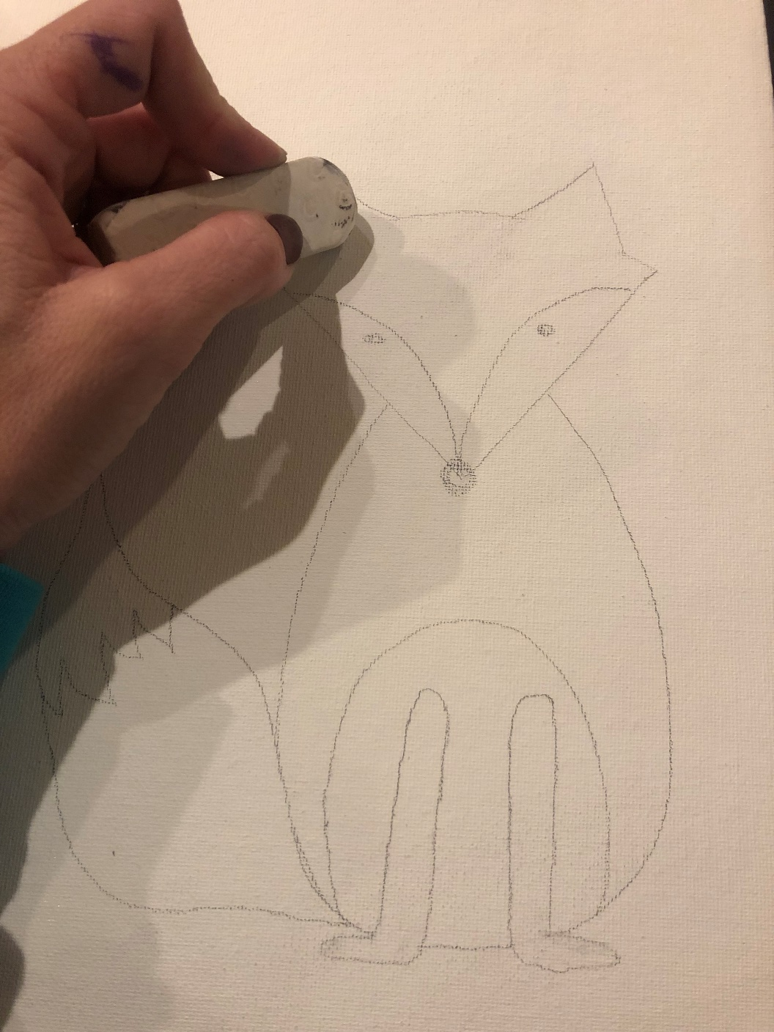
Erase extra lines. They might show through the paint.
Notes:
Choose which Fox you want your students to draw and move the alternative fox slide to the end, to save for another docent’s use.

Slide 7
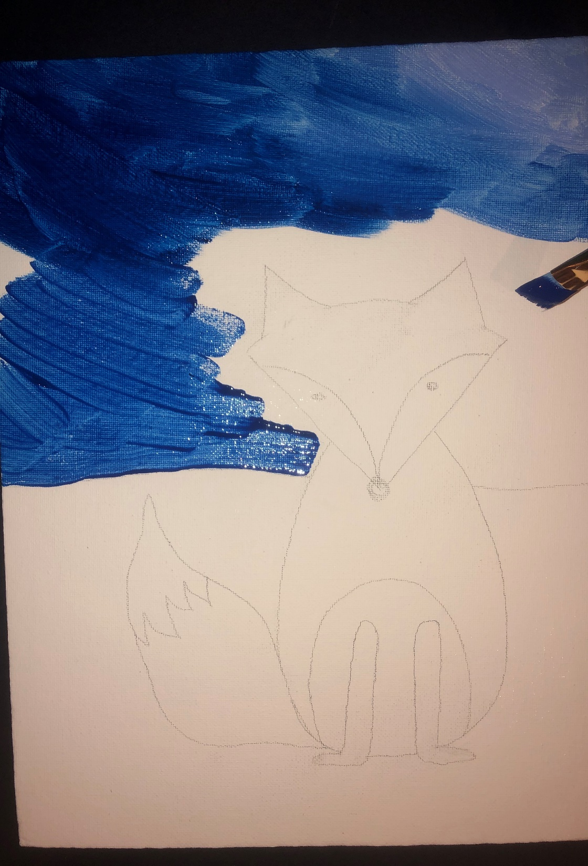
Draw a horizon line behind your fox.
Paint the background blue. Use a small brush around the fox and take your time!

Slide 8
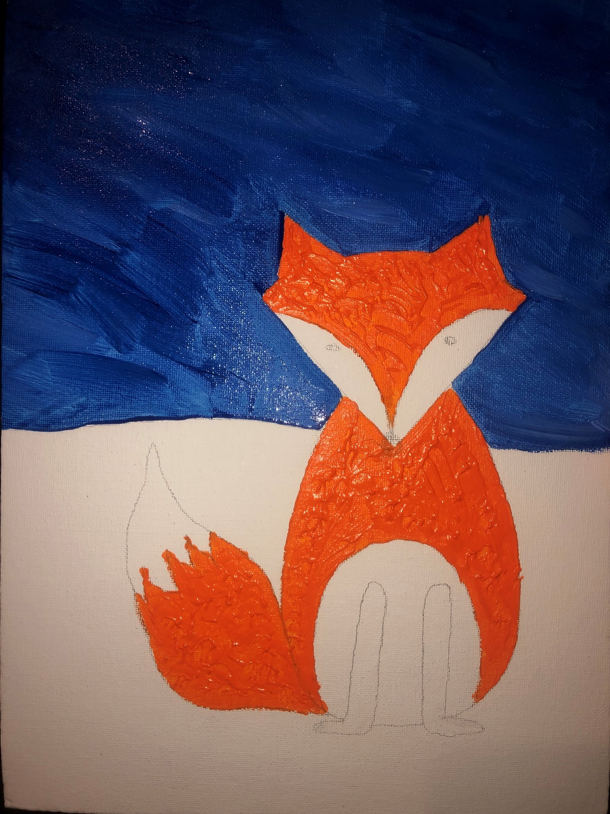
Mix orange paint with joint compound.
Paint in all the orange parts of the fox. Dab at the paint to create a texture that looks like fur.

Slide 9
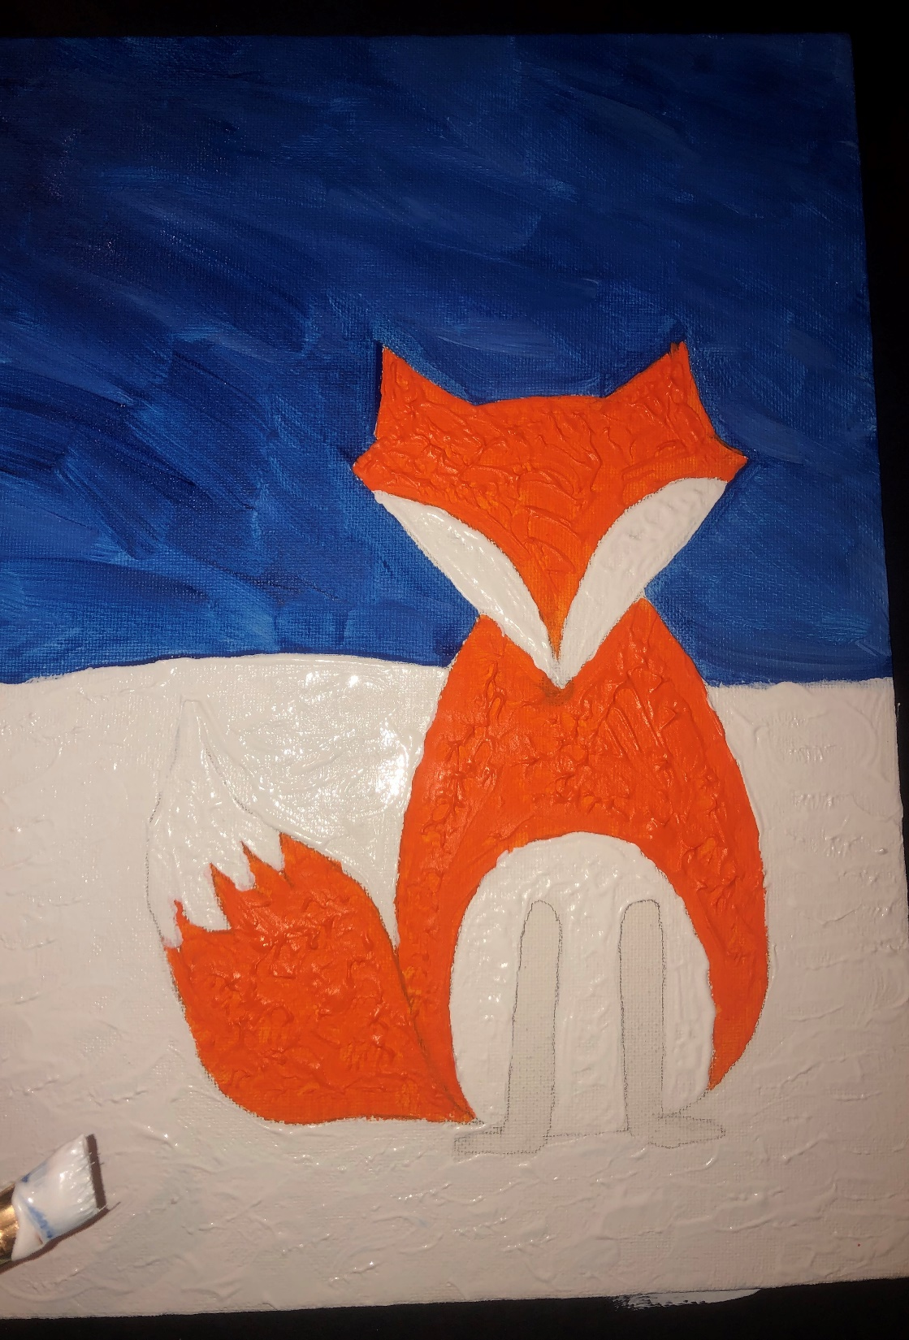
Using the joint compound mixed with white acrylic paint, go back and swirl and paint in your snowy texture.

Slide 10
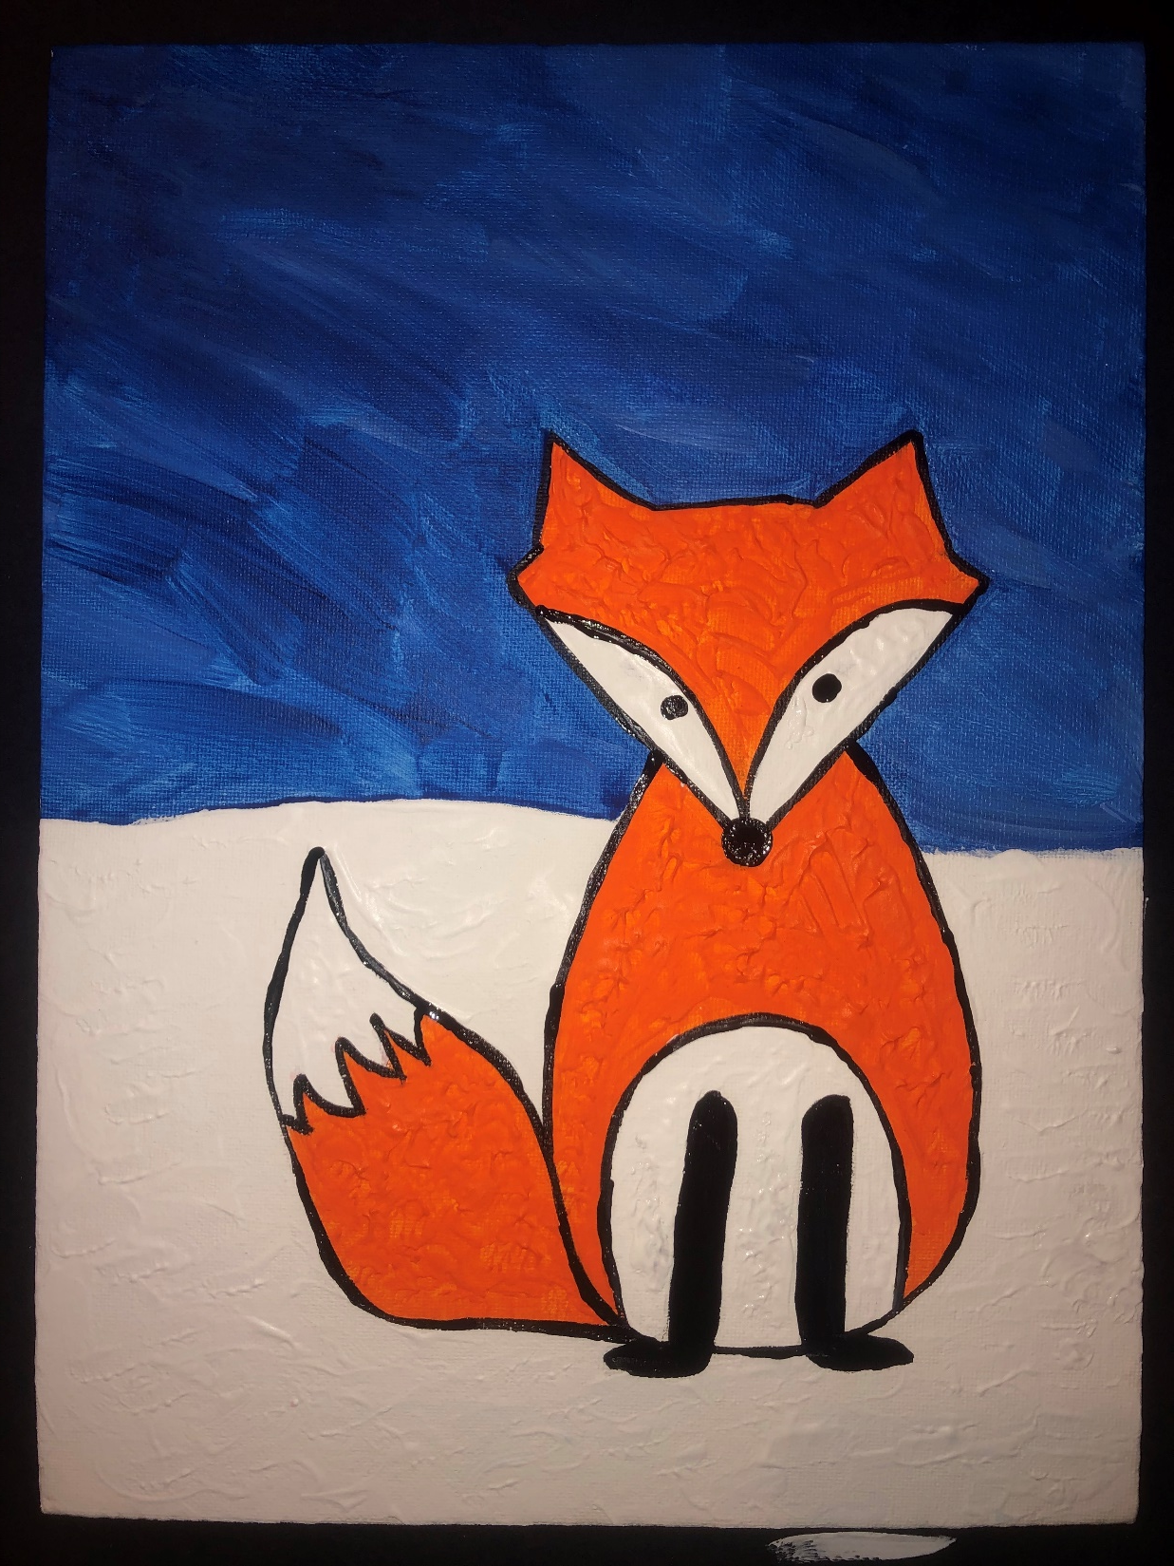
Add all the black parts…nose, eyes, and boots.
Draw black lines to outline your fox. Use a small brush and take your time.

Slide 11
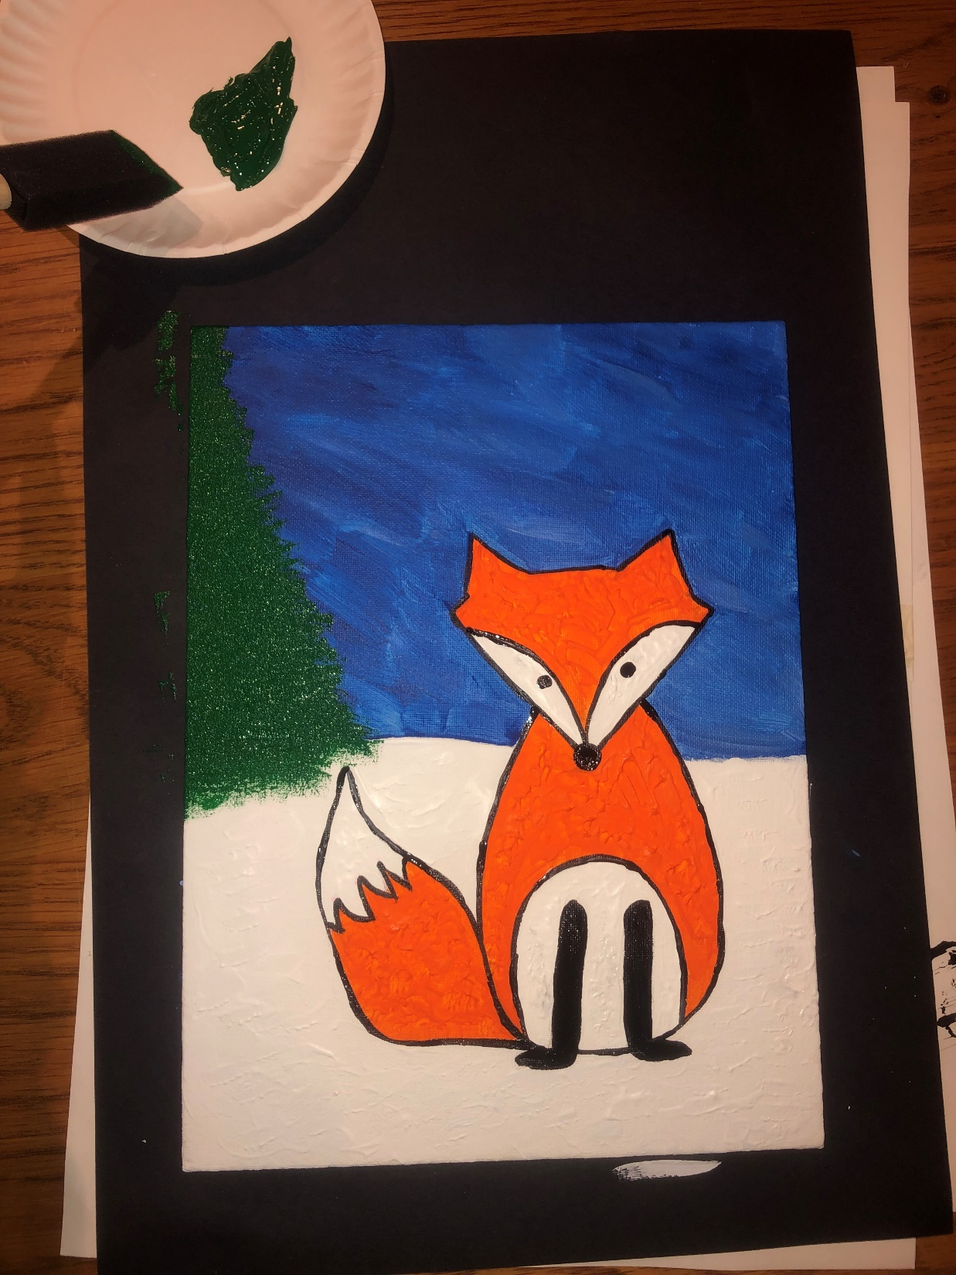
Add a pine tree partially off the page. I was inspired by an artist named Bob Ross.
Bob Ross, born in Florida on October 29, 1942, discovered oil painting while he was enlisted in the U.S. Air Force in the early 1960s. He studied the "wet-on-wet" technique, which allowed him to produce complete paintings in less than an hour. He then became an instructor himself, eventually teaching a TV audience of millions on the PBS show The Joy of Painting. (Ask your parents about him!)
He blended his colors and never needed to fully clean his brushes while he created his landscapes.

Slide 12
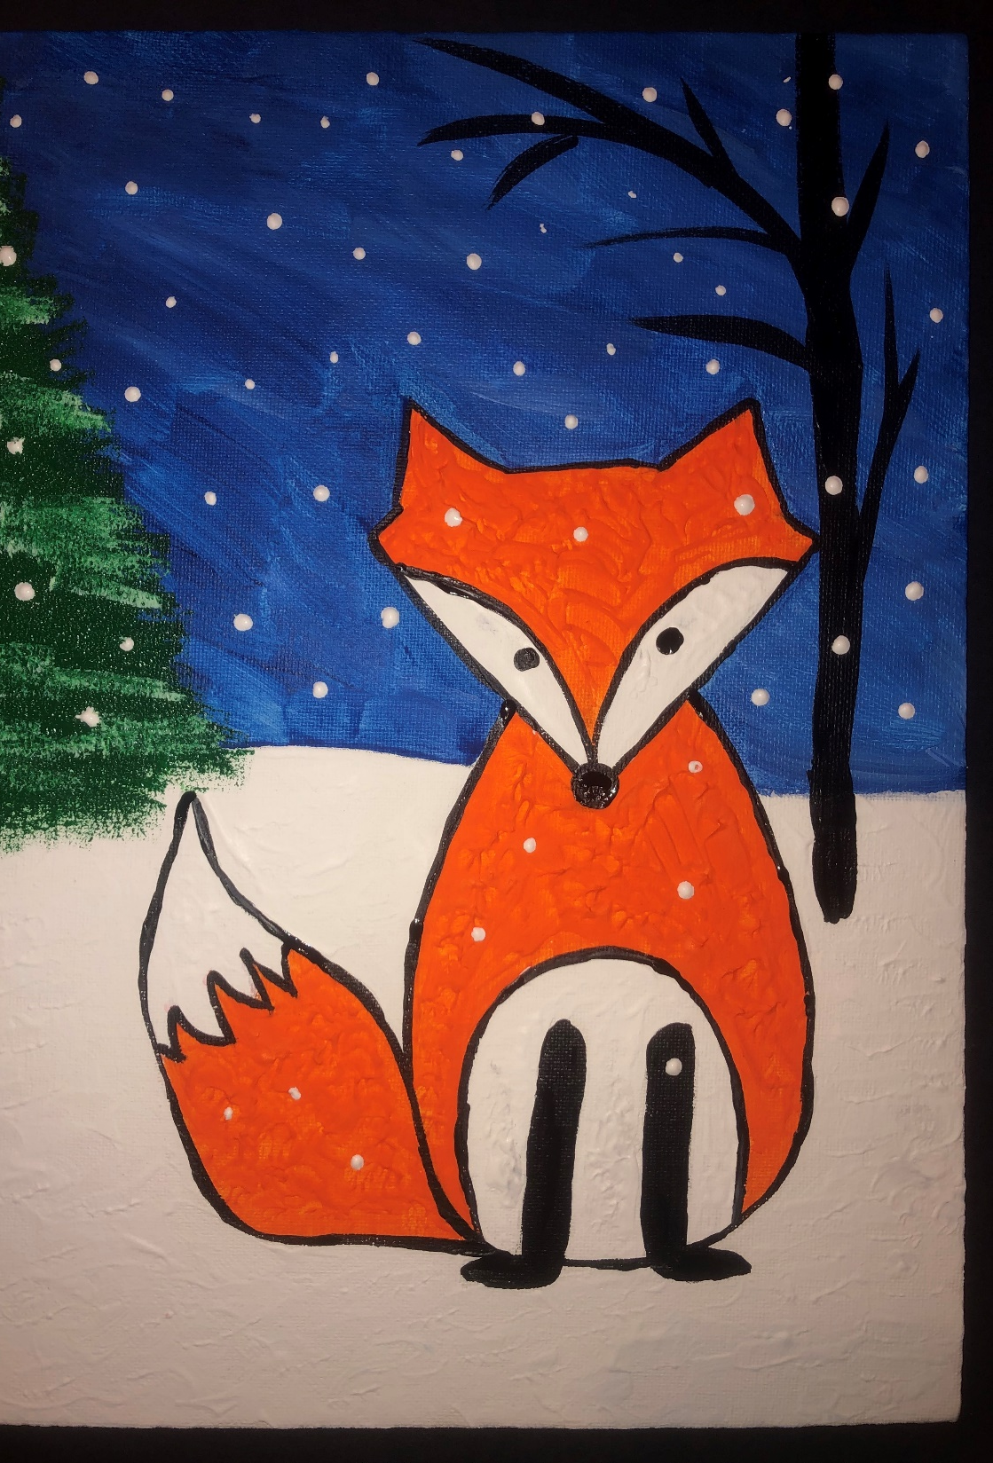
Finishing Details
Add falling snow by dipping the end of your paint brush in white paint and dotting.
Add snow on your tree using the sponge brush in white paint.
You can even add another tree if you would like. This tree was created with black paint and a small brush.

Slide 13
Step by step – handouts per table
Write your name on back of canvas
Sketch (lightly) FOX OUTLINE
Start with the head shape, add details, add body and lastly the tail. The head can be tilted, fat or skinny. Give your fox it’s own character.
Paint BLUE BACKGROUND
You can add white to lighten the blue color if you choose. Acrylic paint dries quickly, so we are going to paint the entire background and add our tree over the top later.
Paint ORANGE FOX PARTS – dab with your brush to give fur texture
Docent – decide whether to use compound to give fox fur texture
Paint WHITE FOX PARTS
Docent – decide whether to use texture on the fox or on the snow or both.
MIX JOINT COMPOUND WITH WHITE PAINT
Use small amounts of compound to keep the paint thin. Too much and you risk your white areas cracking as it dries.
Use the back of your paintbrush to make snow falling. Be careful not to use huge glops!
Paint BLACK PARTS - black nose, eyes, boots (legs), thin tree in background
Paint BLACK OUTLINE
AFTER BLUE IS DRY – Paint GREEN TREE
Once the blue is fully dry, use a foam brush to create your evergreen tree.
Use a blotting up and down motion to give the paint a look of texture, and to be more random with your branches. (reference Bob Ross)
You can add white snowflakes after it is painted if you are careful not to smear the green into the white!

Slide 14
Materials
Size ¾ flat brush, size 10 flat brush. (for Sky and snow areas)
Size 3 flat and size 3 round brush (fill in detail areas of fox)
Size 0-2 round brush (outline the fox)
1” foam paint brush per student (or share)
Acrylic Paints – blockout white, blue, evergreen green, black, orange
Canvas 8x10 or 9x12
Joint compound or Spackle
Water cups
Paint pallets to mix paint with compound to thicken

Slide 15
Alternative Fox style

Slide 16
Erase extra lines. They might show through the paint.
Notes:
Choose which Fox you want your students to draw and move the alternative fox slide to the end, to save for another docent’s use.

